Slide 1



Energy Consumption Monitoring & Prediction Dashboard
Bhavani L
Final year ECE
Edunet foundation intern

Slide 2

Learning Objectives:
Understand data preprocessing
• Perform EDA and visualization
• Build ML models (Random Forest)
• Develop Flask backend APIs
• Create dashboards (Streamlit)
• Integrate frontend & backend
GOAL
Source :
www.freepik.com/

Slide 3
Tools and Technology used:
Python (Pandas, NumPy)
• Scikit-learn
• Flask Backend
• Streamlit Dashboard
• HTML/CSS/JavaScript
• Chart.js & Plotly
• Git, VS Code

Slide 4
Problem Statement:
Energy consumption data is complex and difficult to interpret.
Users need:
• Clear visualization
• Accurate predictions
• Room-wise analysis
• Real-time dashboards

Slide 5
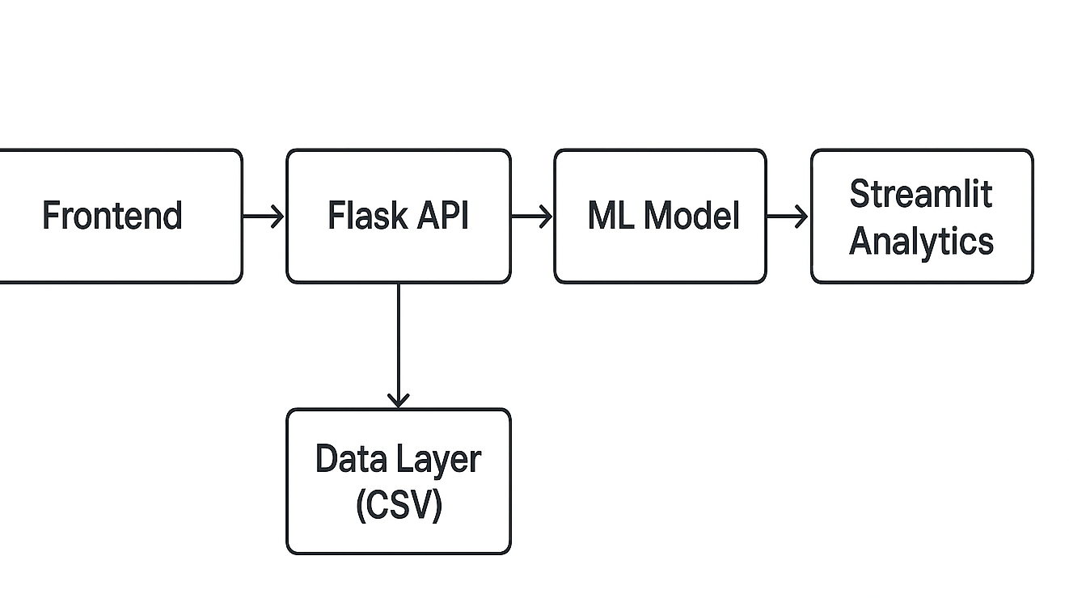
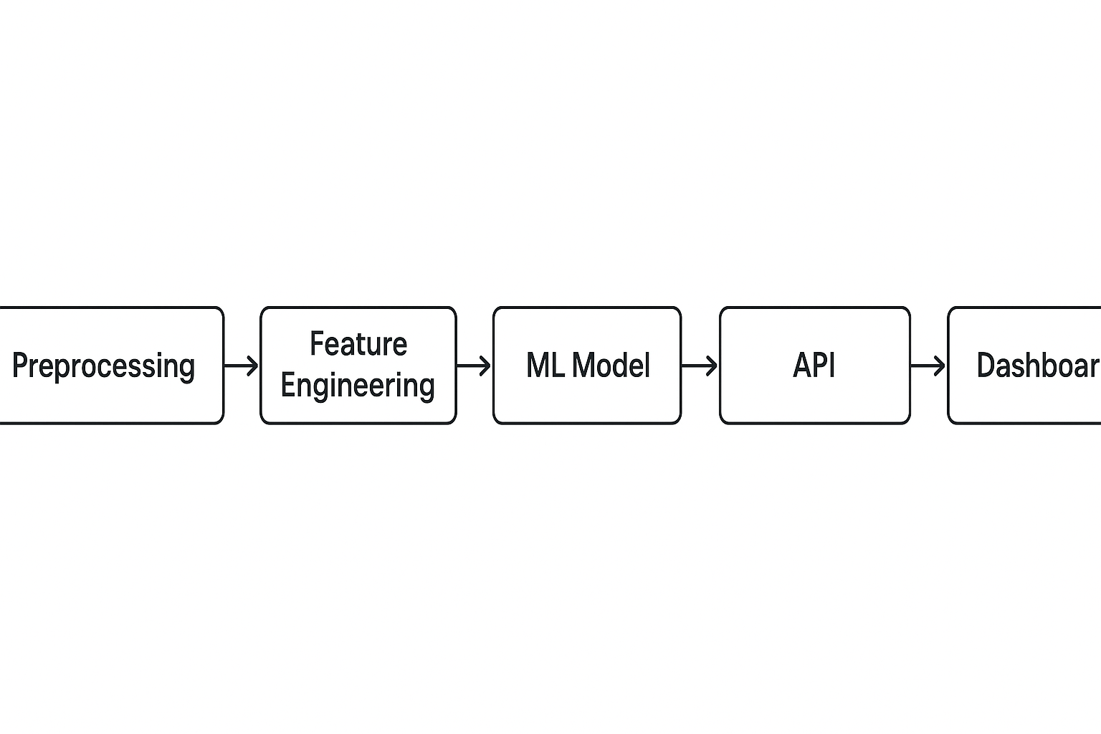
Solution:
ML-powered prediction system
• Interactive dashboards
• Real-time analytics
• Flask-based API integration
• User-friendly UI

Slide 6
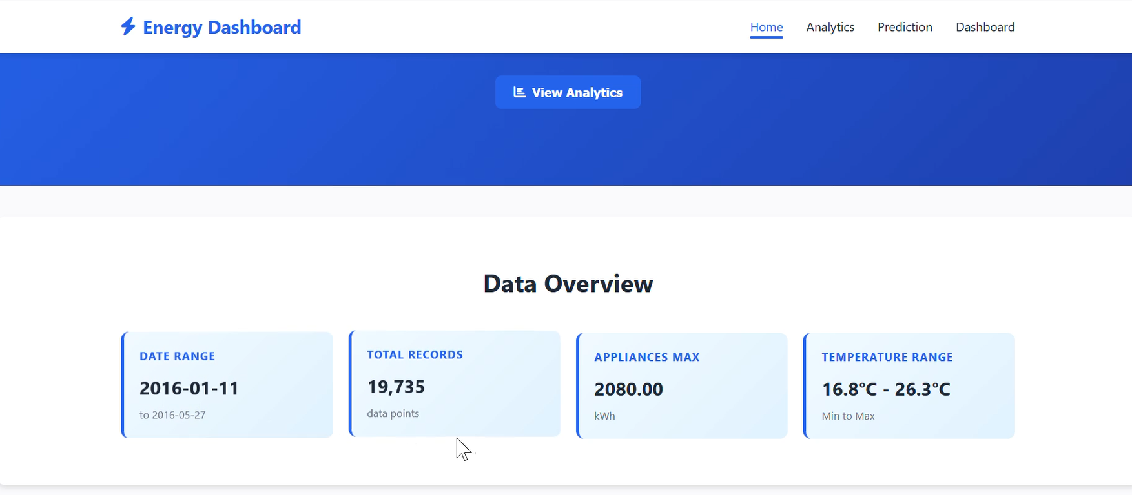
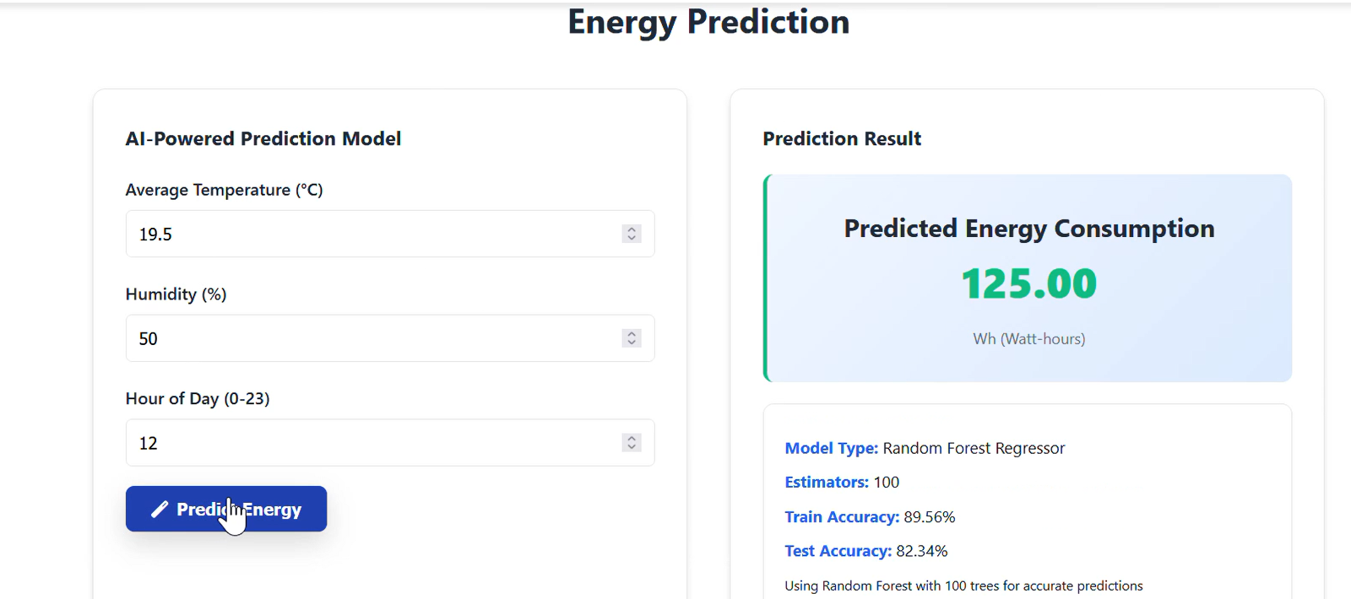
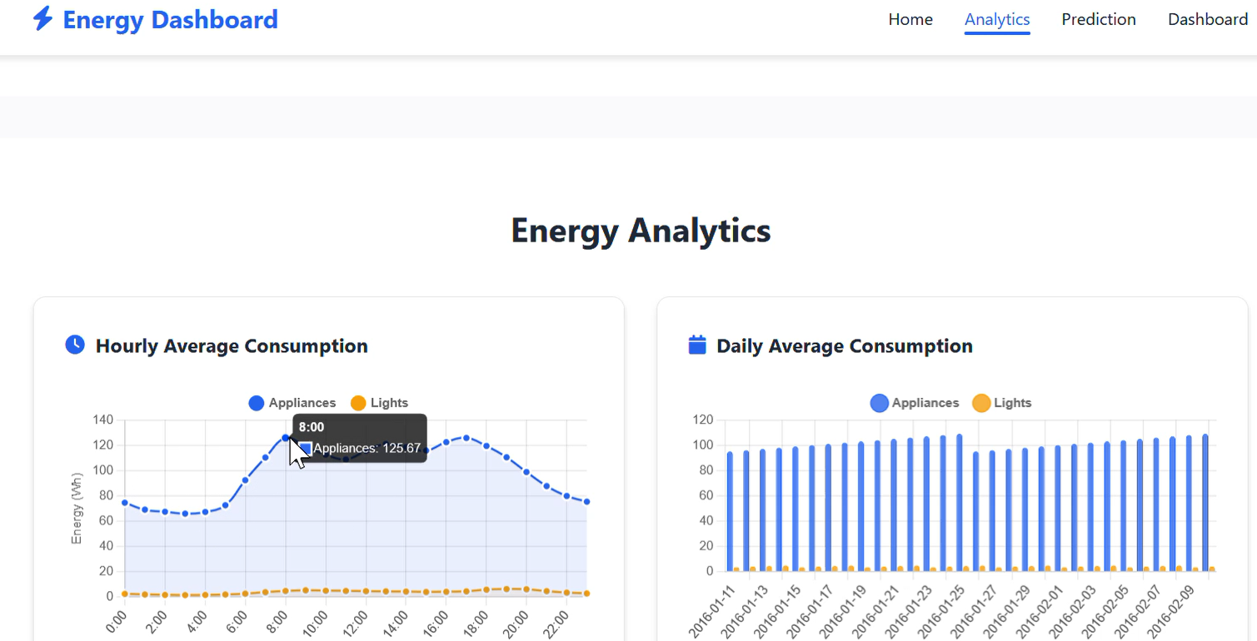
Screenshot of Output:

Slide 7
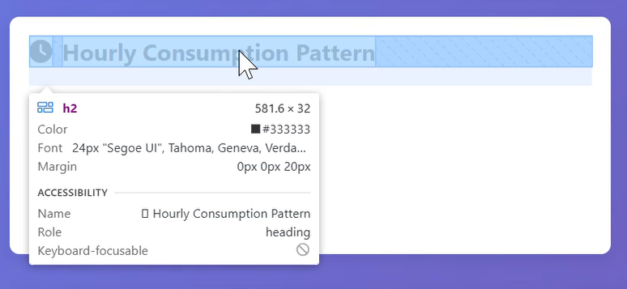
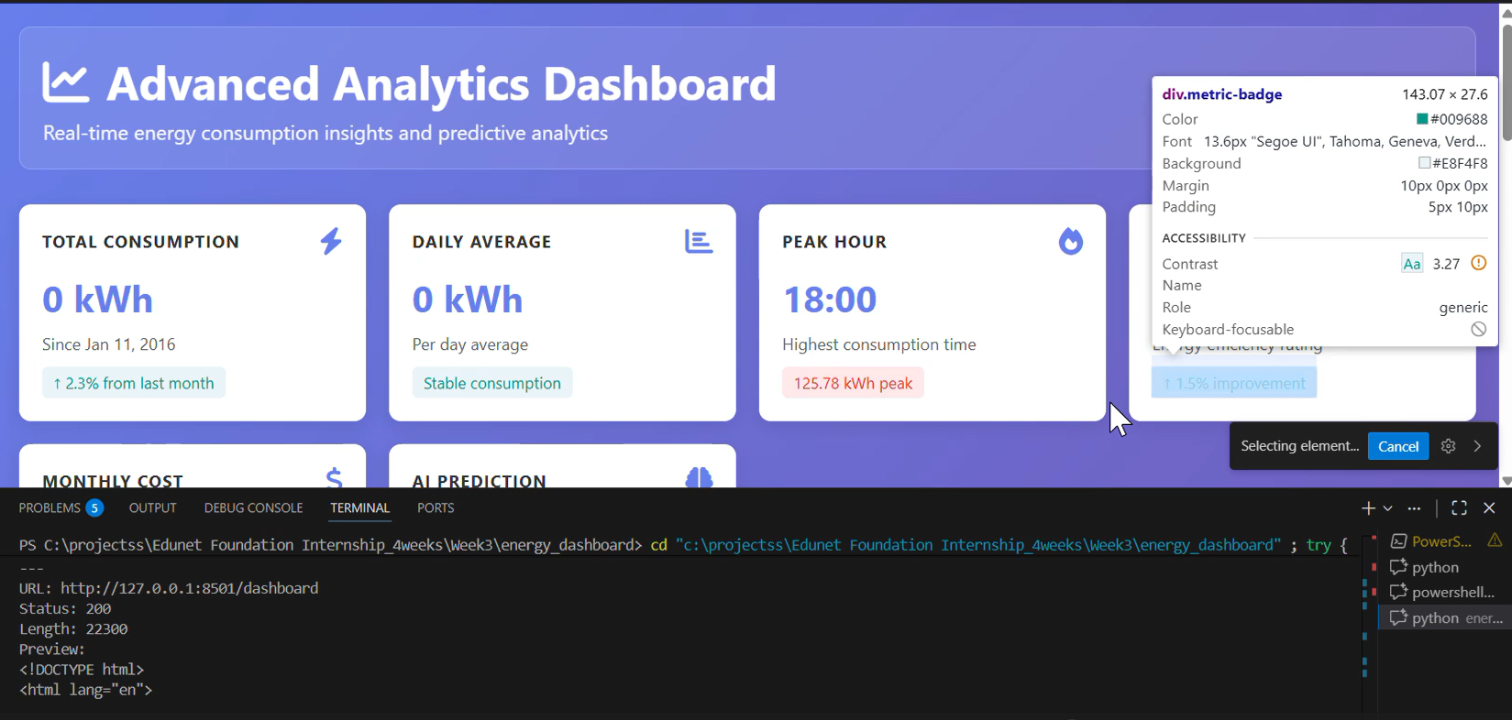
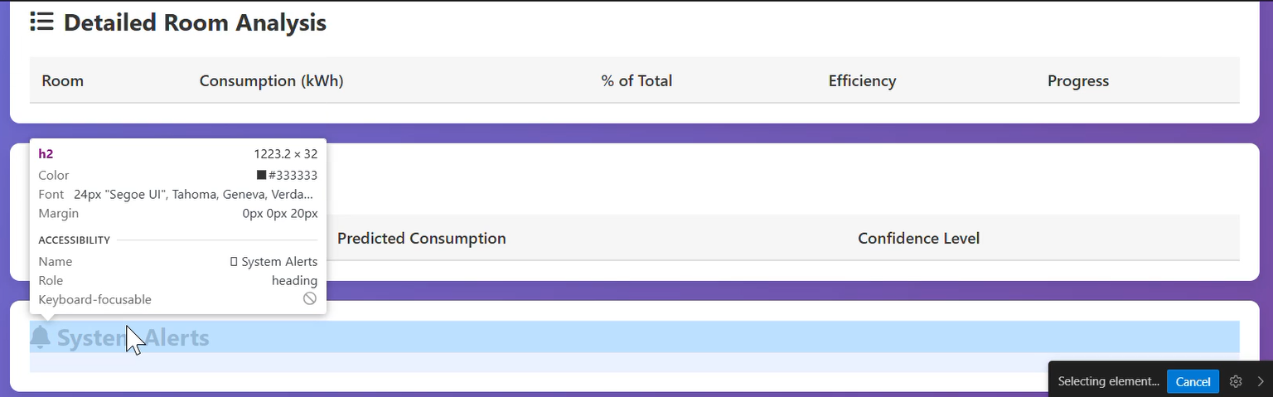
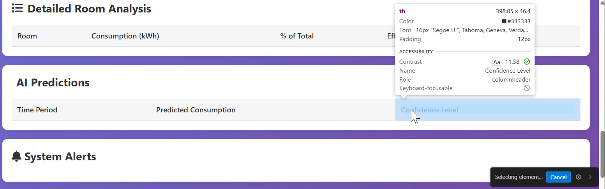
Screenshot of Output:

Slide 8
Conclusion:
Complete end‑to‑end ML dashboard
• Real-time predictions
• Responsive UI & analytics
• Production-ready design

